Slide 1
Expanding the Representation of Permissions in the Informed Consent Ontology (ICO)
  Engaging Patients in Research
  S02: Oral Presentations
Jonathan Vajda
  PhD(c) in Philosophy, University at Buffalo, SUNY
  jonathan.vajda@gmail.com
Notes:
Hello. Thank you to AMIA and the event organizers for giving us a chance to describe our work on the Informed Consent Ontology.

Slide 2
Disclosure Slide
I and my spouse have no relevant relationships with commercial interests to disclose.
Notes:
There are no conflicts to disclose.

Slide 3
Learning Objectives
After participating in this session the learner should be better able to:
  Describe a refactoring process used to transform an application ontology to a reference ontology.
  Describe a semantic approach to representing permissions as used in informed consent processes and documents.
  Represent entities following a design pattern in which atomic classes are preferred
Notes:
After this session, you will be able to describe the refactoring process of shifting an application ontology to a reference ontology, which includes breaking down classes into more atomic classes. Learn about our semantic framework of permissions, for example, one that a patient or research participant might give in an informed consent process.

Slide 4

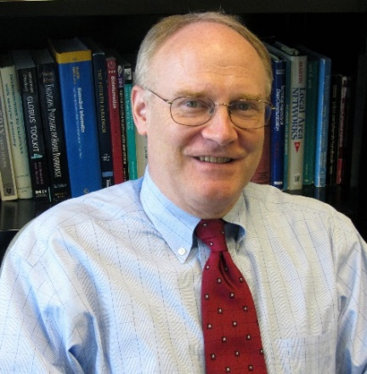



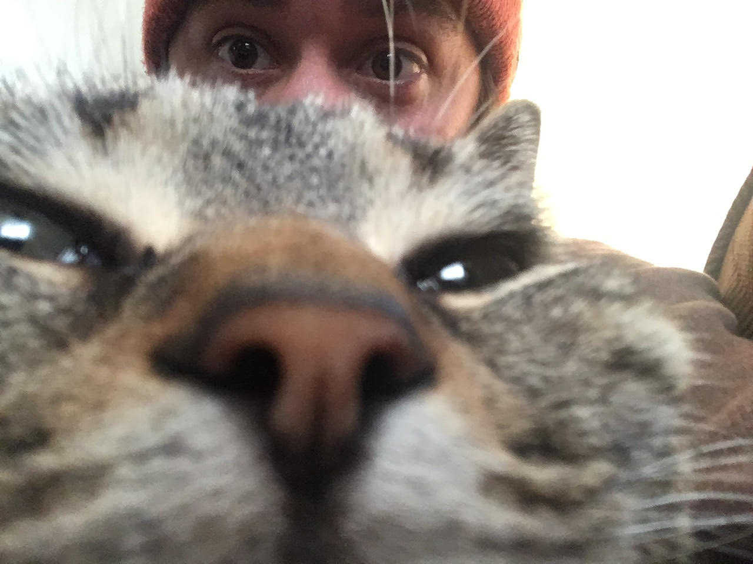
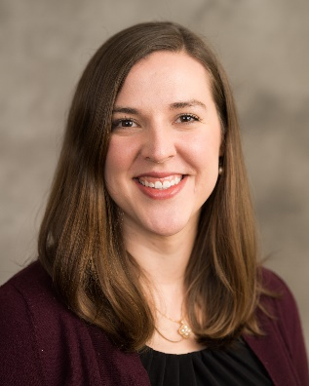
Research Team
This study was supported by the National Human Genome Research Institute (NHGRI) of the National Institutes of Health under award number 5U01HG009454-03.The content is solely the responsibility of the authors and does not necessarily represent the official views of the National Institutes of Health.
Additional support for students was provided by the Michigan Institute for Data Science (Stansbury) and the Robert Wood Johnson Foundation Future of Nursing Scholars Program predoctoral fellowship (Umberfield)
Marcelline Harris
Associate Professor
University of Michigan
Frank J. Manion
Research Investigator
University of Michigan
Cui Tao
Professor
UT Health Science Center at Houston
J. Neil Otte
Senior Ontologist
JHU Applied Physics Lab
Jonathan Vajda
Graduate Assistant
University of Buffalo
Cooper M. Stansbury
Research Associate
University of Michigan
Elizabeth Umberfield
PhD Candidate
University of Michigan
Notes:
I have had a great joy working with this team across several institutions. This project was funded by the NIH, and individuals on our team were funded by the Michigan Institute for Data Science, and the Robert Wood Johnson Foundation.

Slide 5
Followed OBO Foundry Principles
HUGE shout-out to those participating in Open Biomedical Ontologies (OBO) Foundry, and Ontology for BioBanking (OBIB) weekly editing calls including
Chris Stoeckert (U Penn)
Jie Zheng (U Penn)
Mark Miller (U Penn)
Jihad Obeid (MUSC)
Mathias Brochausen (U Florida)
Bill Duncan (University at Buffalo)
Helena Ellis (Biobanking Without Borders)
Notes:
A huge shout-out to other collaborators in related ontologies, and especially those in OBIB and other OBO foundry ontologies who gave regular, critical contribution to our representation.

Slide 6
Problem & Our Solution
Need for a common information resource that provides:
  A semantic framework for reconciling heterogeneous information related to processes and documents in the informed consent domain.
  A way to track regulatory frameworks under which biospecimens & data collected, transferred across jurisdictions, and changes to regulations.
  Terminology to enhancing tracking permissions, and not only documents
Refactor the Informed Consent Ontology (ICO): From application to reference ontology
  A semantic framework for reconciling heterogeneous information related to informed consent processes and documents.
  This talk: Expansion of key atomic classes of roles, permissions, regulations, jurisdiction, stasis.
Notes:
What are we trying to make progress on? There has been no adequate semantic framework to enhance data annotation for many entities in the informed consent context, including, for example, permissions and obligations across a variety of regulatory frameworks. What is the goal, then, or what can you do with our representation? We provide a reference ontology that be used to tailor to your particular needs in an application ontology. Likewise, we assert classes you can use to annotate social-legal and ethical entities, such as permissions and obligations in a healthcare context.

Slide 7
Refactoring Methods
Five iterative steps
Review of original ICO classes and relations
Testing and revising core design patterns
Alignment with other ontologies
Adding new classes and relations
Evaluation – emphasis on flexibly representing canonical use cases
Notes:
Our methods were driven by the interdisciplinary nature of our development team. Our team includes informaticists, software engineers, and philosophers. We worked together to review, test, align, expand, and evaluate an ontology according to best practices.

Slide 8
1. Review Original ICO Classes & Relations
Reviewed all classes and labels of ICO ‘v1’ definitions in a spreadsheet:
Identified and validated essential content
  Best practice documents
  Scoping review
  Use case development
  Review by domain experts
Collaboratively evaluated original ICO content, key decisions:
  ‘retain’, e.g., because the term conformed to best design practices and had no typos
  ‘revise’, e.g., because the term’s definition used inconsistent terminology
  ‘deprecate’, e.g., because the term fell outside ICO’s intended domain of representation
Notes:
We reviewed all class labels and definitions in ICO version 1, and we marked each class either as deprecate, revise or retain, with justifications for this determination. Justifications were given according to best practice standards, a review of domain scope, and according to our target usage with paradigmatic use cases. These use cases were provided by our partners in other ontologies.

Slide 9
2. Create Design Patterns
Design pattern: use more generic terms and then assert their relationships
  Example of ICO v1 class: ‘explaining to participant about research investigation’
  Does class label use existing terms? ‘participant role’ and ‘research investigation’ already exist
  Create new label for the missing generic term: ‘act of explaining’
  Finally: explicitly assert the relations between these entities, so the original meaning is kept
Good Design Principles
  Continuants (objects) should not be defined by their circumstances or associations
  Occurrents (processes) should not be defined by their participants, or when or where they occur
  Doesn’t this yield information loss? No. We can assert relations to aid computer reasoning, so that participants and their circumstances are also represented
Notes:
Here we want to emphasize a good design pattern: wherever possible, reuse terms and assert the relationships that hold between the classes or its instances. This class can be broken down into a more atomic class or classes. The virtue of this is approach is that we can reuse classes already asserted elsewhere in our ontology (or in a different ontology). Our design pattern is generalizable and predictable to someone who wants to add further classes.

Slide 10
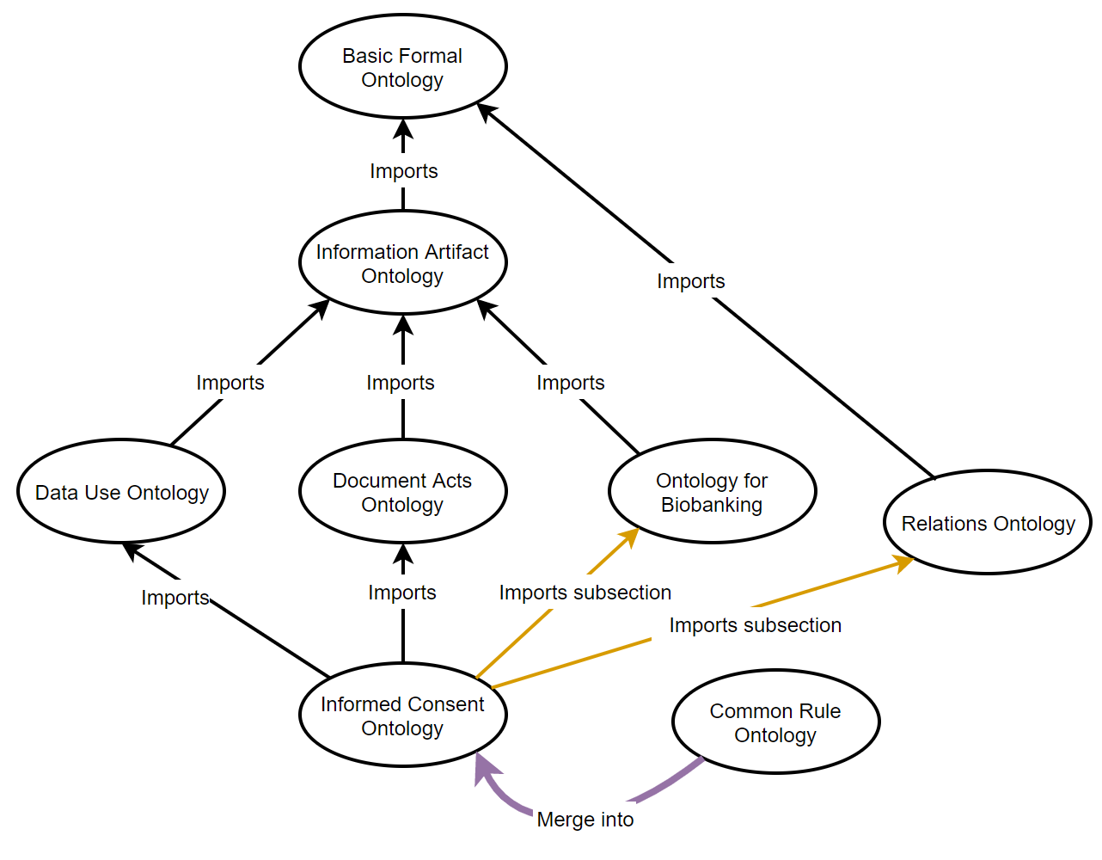
3. Align with other Ontologies
Basic Formal Ontology (BFO)
Top level ontology, designed to support interoperability of scientific research
Information Artifact Ontology (IAO)
Categorizes information entities
Document Acts Ontology (D-Acts)
Describes what people can do with documents
Data Use Ontology (DUO)
Represents data use conditions
Ontology for BioBanking (OBIB)
Represents biobank repository and biobank administrative information
Relations Ontology
Collection of OWL relations for use across ontologies
Common Rule Ontology
Represents US Common Rule - Basic requirements for obtaining informed consent and the documentation of informed consent
Notes:
OBO Foundry ontologies are modular. Our ontology fits within an ecosystem of ontologies, may of which we had regular collaboration to ensure alignment along the way. We also negotiated which classes belonged in house, or were to be managed by other related ontologies. For example, if a class was more generic than our scope, or whether the class properly falls within the scope of an ontology we import. That way it is managed by the appropriate domain experts.

Slide 11
4. Adding New Classes and Relationships
Deontic ethics
  Concerned with obligations, permissions, and related concepts.
  From the Greek word δέον (deon) for ‘duty’ or ‘obligation’
Descriptions and directives
  Specifications regarding what action types are allowed, not allowed, required
  Warning: documents are decent proxies for talking about deontic entities indirectly, but without roles this shortcut loses important representation
Related processes and sub-processes of informed consent processes e.g.,
  Act of authorization
  Act of consent
  Act of disclosure
  Act of sharing data
Stasis and Jurisdiction
  Model when and where artifacts (e.g. documents) have force
Notes:
We expanded the representation of deontic entities such as permissions, obligations, or prohibitions. We built on the Document Acts Ontology, which represents how social and legal arrangements change through social acts, such as speech acts or with documents intervening. We are able to enumerate different classes of information entities that describe or prescribe what ought to be or should be done. We also assert classes of processes which are necessary for consent or the action types that fulfill what has been prescribed. While documents are good ways of talking about deontic entities, we want to represent the deontic entities themselves – which has to do with representing agents and the social arrangements they are in.

Slide 12
Permissions, Obligations, Prohibitions
What is a permission?
Common approaches
  An action permission is a shorthand for the ongoing activity of allowing
  Document permission is a piece of information that says what is allowed
  Attribute permission is just the quality or property of a thing or process
Our representation: a permission is a role, a certain kind of deontic role
  See Document Acts Ontology (D-Acts) for more
A permission is realized in the act of performing what was permitted
Who can bear permission roles? Humans, organizations, or other agents
Notes:
Before describing what a permission is, let’s describe some alternative approaches and what is wrong with them.
A permission is not an activity, since a permission is something that continues through change or endures through time. A permission can outlast the person who allows the action. So, a permission is not an action, but it is definitely a result of an action.
A permission is not a document, for two reasons. Permissions were given to people before society was literate. Likewise, someone may write or fill out a document that says what is allowed, but there is no permission created yet, because it was not used to communicate what is allowed. So, a document is neither necessary nor sufficient for a permission. Even though some permissions require documentation to be enforced, a permission itself is not a document.
A permission is not a quality of a thing or a process. Humans are not qualitatively different when their actions permitted. This point can also be made for processes: the same meticulous, life-giving surgery may be permissible with consent but impermissible without consent. The action itself is qualitatively the same in both cases, but the situation is different. So, we need to talk about the context.
Instead, a permission is going to be understood in terms of a role one bears in a context, and a permission role is realized or fulfilled in a that action that is permitted. Who can bear a permission role? Humans, organizations, other agents.

Slide 13
BFO ‘role’
A role is a realizable entity that is externally grounded
  Student role, research subject role, customer role
A role is realized (or actualized) in a process or activity
  Taking a quiz, participating in an experiment, making a purchase
  A role exists even when it is not being realized
Formal description of individual persons who bear roles:
  An investigator = a human being who has a investigator role
  A research participant = a human being who has a research participant role
ICO’s representation enables annotation of data for deontic roles
  The role has a specific bearer at a particular time, which can be regulated by the document
Notes:
Let’s get into the theoretical background for roles. Some example roles include a patient role. A person who has a patient role can perform various activities as a patient, such as fill out paperwork or schedule an appointment. Their activities are realizations of that role.
When we say someone has a permission role, we just mean that performing the action is a realization of that role, and that there are certain normative expectations involved about what should or should not happen.
This class of entity allows us to annotate which agents and organizations bear what roles at what time, in what jurisdiction. When a document specifies what may be permitted for a researcher, the deontic role is the corresponding entity that an agent acquires to perform research. Without the class deontic role, we have data we want to represent, but must rely on some proxy, such as a document, but this fails to represent the situation accurately.

Slide 14
Example of New Design Pattern
Design Patterns for Permission Roles
Documents and their parts
  Information entities relate to documents as parts, rather than defined as document parts: description of benefit, description of risk, questionnaire, etc.
Formal relation: prescribes
  Obtains between an ‘directive information entity’ and some ‘entity’, specifying that something is to be done
Deontic Power Role
  A deontic role which is realized in the creation, modification, or revocation of a deontic role
deontic
power role
homo sapiens
bearer of
agent in
informed consent process
has output
permission role
has output
prescribes
informed consent form
directive information entity
has part
Notes:
Here is the basic design pattern for the creation of a permission. It starts with a person who has authority in the first place. This person has a deontic power role – that is, a role which is realized in acts of creating, modifying, or revoking deontic roles. For example, a research participant has a deontic power role and participates in an informed consent process that creates a new permission role. The process also produces a document, such as a completed informed consent form, with a collection of directives that prescribe how that permission role is realized. The researcher then bears that permission role, and when they perform those research tasks that realize that role.

Slide 15
Example of New Design Pattern
Design Pattern for Jurisdiction and Stasis of Regulation
Jurisdiction
  Deontic power roles can only be realized in certain locations (BFO: site), i.e. a jurisdiction.
Stasis of regulation
  Regulations prescribe or prevent the realization of a deontic power role, and a stasis can be used to describe when and where they occur
ICO: permission role
ICO: informed consent form
ICO: stasis of regulation
BFO: temporal region
prescribes
participates in
occurs at
has output
ICO: informed consent process
has output
participates in
government regulation
participates in
ICO: jurisdiction
prescribes
Notes:
We also expanded the representation of when regulations are in force. For example, the HHS 45 CFR 46 ‘common rule’ applied for a time, in the jurisdiction (that is a site). Yet this law has now been updated. ICO can enhance computer reasoning for these changes in regulation. Our representation includes the class ‘stasis of regulation’, functionally provides a way to index permission roles and documents to the time and place these regulations are in force. This is helpful for querying what regulations are or were in force for a biospecimen not only when it was collected, but also over time as compliance standards change. The Common Rule Ontology (or CRO) represented the regulations and roles described by the Common Rule; CRO is no longer a separate ontology, but is now fully included into ICO and aligned with our design pattern.

Slide 16
5. Evaluation: Descriptives
ICO as a Reference Ontology
 | ICO v1 (application ontology) | ICO v2 (reference ontology)
Total Class Count (includes imported) | 530 | 893
Total ICO Classes | 176 | 303
Total Annotation Properties (includes imported) | 51 | 77
Total AnnotationProperty Count | 3 | 4
Total ObjectProperty Count (includes imported) | 47 | 95
ICO ObjectProperty Count | 3 | 6
Total Obsolete Classes | - | 46
Notes:
Here is a brief evaluation of our progress. The result is that we imported and extended our representation dramatically. This shows how we deprecated or revised ICO classes and CRO classes and then merged.

Slide 17
Summary
Using refactoring processes, we have extended ICO from an application ontology to a reference ontology.
Now classes are more atomic – Important for reuse in other ontologies (e.g., local application ontologies, NLP, value sets in non-BFO based ontologies).
Importantly, we have modeled permissions, obligations and other roles that are central to responsible use and reuse of biospecimens and data.
Released under Creative Commons License
  https://github.com/ICO-ontology/ICO
  Downloadable from ontology repositories (Ontology Lookup Service, BioPortal, OntoBee)
Ongoing development: currently testing NLP based retrievals of information from informed consent forms, based on ICO terms.
Notes:
Just say what’s on there.

Slide 18
Thank you!
  Email me at: jonathan.vajda@gmail.com

